Slide 1
Reach for the Stars

Slide 2

I built a shiny star ship

Slide 3

Made of silicon and glass

Slide 4
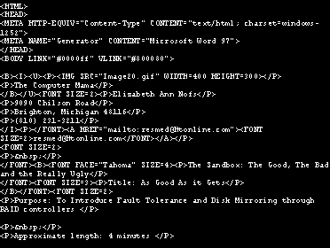
little bits of code

Slide 5

and a dozen lights that flash!

Slide 6

Its me and my computer

Slide 7

Eager to join the race

Slide 8

O the things we can explore

Slide 9
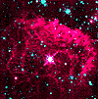
As we cruise through cyberspace!

