Slide 1

The Rest of the Story ;-)
Spring has sprung, the grass has riz,
I wonder where the flower iz.

Slide 2
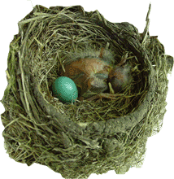
The Wind Riz, Then it Blew
text

Slide 3
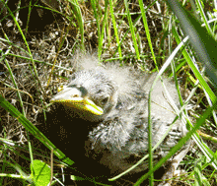
The Rain Friz, Then it Snew
Spring is Gone.
Fall is Fell.
Winter is here, and it’s colder than usual.

