Slide 1
Spring Forward!
2007 Sales and Marketing
Notes:
The Complete Guide to PowerPoint ®

Slide 2
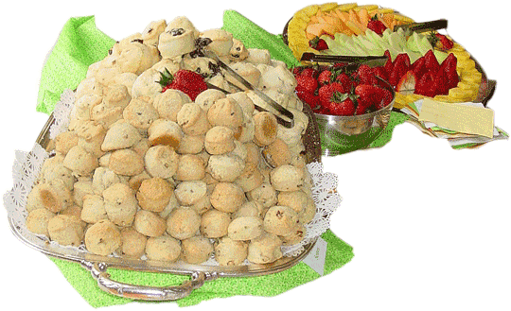
Spring Has Sprung
New Products
Mint ice
Wild Rose moon

Slide 3
The Grass Has Riz
Our Team
Elizabeth
Jeanette
Ted
Alex
Clair
Pat
Leo

Slide 4
Statistical Process Control (SPC)
Define Program and Goals
Plan the Process
Implement the Plan
Analyze the Results
Improve the Process

Slide 5
New Product Sales!

Slide 6
The Rest of the Story ;-)
Spring has sprung, the grass has riz,
I wonder where the flower iz.

Slide 7
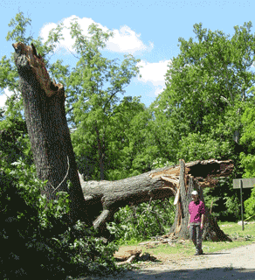
The Wind Riz, Then it Blew

Slide 8
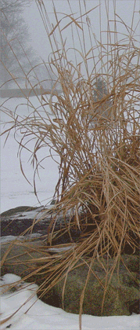
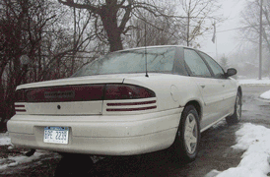
The Rain Friz, Then it Snew

Slide 9
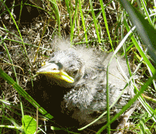
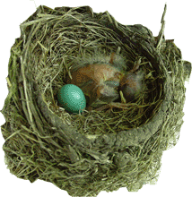
Spring is Gone.

Slide 10
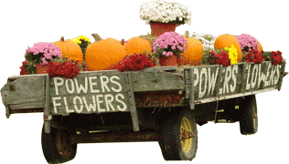
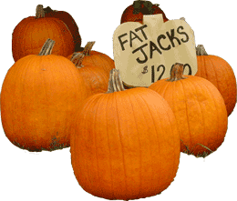
Fall has Fell.
Product | Packaging | Web Pages | Launch
Fruit | √ | √
Veggies | √ | √
Meats | √
Ice Cream | √ | √ | √

Slide 11
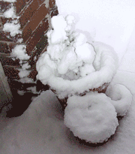
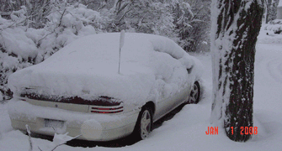
Winter is here, and it’s colder than usual.
New Products
Mint ice
Wild Rose moon

